Slide 1
Resilience Testing
In Cloud Based Environment

Slide 2

Topics
Agenda
What is Resilience Testing
What is Chaos engineering
Why Test infrastructure in production
Simian Army
Case Study
Q & A

Slide 3
Key Takeaways
Some of the key techniques to help build your applications hosted on cloud to be resilient and more reliable
These techniques are much inspired by Netflix Chaos Engineering
Notes:
What a resilient business looks like
A good deal of a business’ resiliency is indirectly related to technology — things like strong senior executive support, a willingness to challenge assumptions, commitment to transparency and collaboration, an organizational culture promoting continuous employee education, and sharing knowledge with a trusted network of organizations.
Other characteristics of an organization’s resilience are very much about technology. Resilient businesses…
Embrace technological innovation with due diligence, balancing the risks inherent in slow adoption (e.g., falling behind competitors, loss of reputation) with the risks of experimenting with innovations that turn out to be unsuccessful
Realize that because their growing reliance on hyper-connectivity and data assets exposes them to cyber criminals, they must proactively invest in constantly evolving, state-of-the-art security measures
Understand that the complexity of today’s technologies — mobility/BYOD/IoT (the Internet of Things), social media, cloud services, integration trends, big data, virtualization, etc. — demands an unprecedented level of automated, integrated, real-time monitoring and management.
Getting there: 8 best practices for better resilience
To begin developing a strategy of resilience…
Identify what will make your business resilient, including organizational and technological factors as outlined above
Determine how to measure those factors so you can build appropriate metrics into your key performance indicators (KPIs)
Get proactive: set up extensive real-time monitoring and alert systems to measure performance and security stance, and to flag issues ASAP
Establish procedures for evaluating technology innovations to determine whether your business should adopt them and how
Base decisions on reliable independent data
Build robust technology alliances that protect your confidential data and enable you to collaborate effectively
Practice for disruption with regular and realistic testing of business continuity plans — and don’t forget that specific recovery plans are less useful and dynamic than the ability to create impromptu plans in response to unanticipated situations
Help employees during disruptions, because without a resilient workforce you cannot expect to sustain a resilient business

Slide 4
“Resiliency is the ability of a system to gracefully handle and recover from failures”
The nature of cloud hosting, where applications are often multi-tenant, use shared platform services, compete for resources and bandwidth, communicate over the Internet, and run on commodity hardware means there is an increased likelihood that both transient and more permanent faults will arise.
Detecting failures, and recovering quickly and efficiently, is necessary to maintain resiliency
Source: https://msdn.microsoft.com/en-us/library/dn600215.aspx

Slide 5
AWS: Well-Architect Framework
(1) Security
The ability to protect information, systems, and assets while delivering business value through risk assessments and mitigation strategies
(2) Reliability
The ability of a system to recover from infrastructure or service failures, dynamically acquire computing resources to meet demand, and mitigate disruptions such as misconfigurations or transient network issues
(3) Performance Efficiency
The ability to use computing resources efficiently to meet system requirements, and to maintain that efficiency as demand changes and technologies evolve
(4) Cost Optimization
The ability to avoid or eliminate unneeded cost or suboptimal resources

Slide 6
AWS: Well-Architect Framework
(1) Security
The ability to protect information, systems, and assets while delivering business value through risk assessments and mitigation strategies
(2) Reliability
The ability of a system to recover from infrastructure or service failures, dynamically acquire computing resources to meet demand, and mitigate disruptions such as misconfigurations or transient network issues
(3) Performance Efficiency
The ability to use computing resources efficiently to meet system requirements, and to maintain that efficiency as demand changes and technologies evolve
(4) Cost Optimization
The ability to avoid or eliminate unneeded cost or suboptimal resources

Slide 7
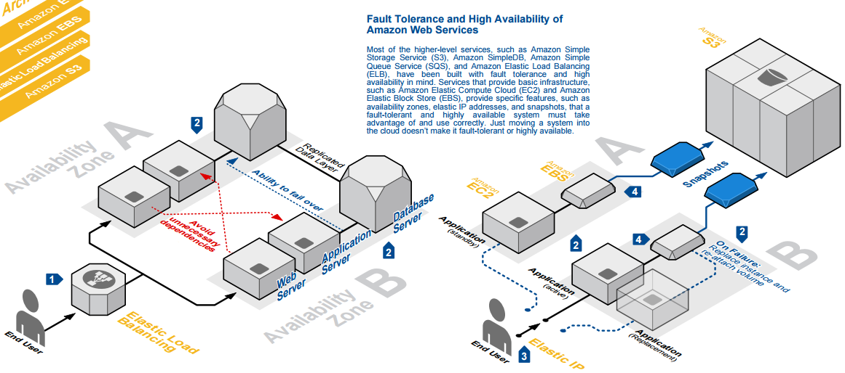
1
Load balancing is an effective way to increase the availability of a system. Instances that fail can be replaced seamlessly behind the load balancer while other instances continue to operate. Elastic Load Balancing can be used to balance across instances in multiple availability zones of a region.
Source: http://media.amazonwebservices.com/architecturecenter/

Slide 8
2
Availability zones (AZs) are distinct geographical locations that are engineered to be insulated from failures in other AZs. By placing Amazon EC2 instances in multiple AZs, an application can be protected from failure at a single location.

Slide 9
3
Elastic IP addresses are public IP addresses that can be programmatically mapped between instances within a region. Elastic IP addresses can be used to work around host or availability zone failures by quickly remapping the address to another running instance or a replacement instance that was just started.

Slide 10
4
Valuable data should never be stored only on instance storage without proper backups, replication, or the ability to re-create the data..

Slide 11
AWS Outage Sep 2015 : How Netflix weathered the storm
Problem : Amazon services run out of datacenters in North Virginia US-EAST-1 site , it was a complete regional infrastructure outage.
Impact : Users of Netflix, Tinder, Airbnb reported problems accessing content during the six- to eight- hour period that Amazon's cloud services were affected.
Netflix Strategy : Netflix was able to rapidly redirect traffic from the impacted AWS region to datacenters in an unaffected area. Netflix was able to do this because it practices what it refers to as multi-region, active-active replication - where all of the data needed for its services is replicated between different AWS regions in a way that allows rapid recovery from failures.
Outcome : Netflix had no significant impact on its streaming capabilities.
Netflix weathered the storm by practicing Chaos engineering and making itself resilient to service disruptions and outages.
Source: http://www.techrepublic.com/article/aws-outage-how-netflix-weathered-the-storm-by-preparing-for-the-worst/

Slide 12
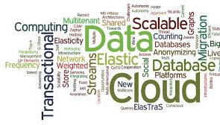
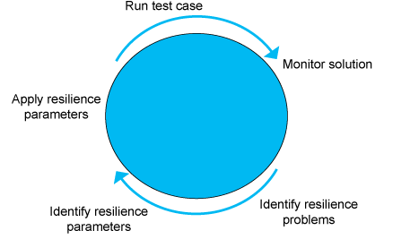
Introduction to Resilience Testing
Application resilience is the ability of an application to react to problems in one of its components and still provide the best possible service.
Why Test for Application Resiliency
Complex, multiple technology environments have a higher degree of failure and security issues. Testing application resilience provides the ability to assess:
Non-Conformance to application resiliency best practices
Security and Privacy issues
Scalability
Risk to your business due to application failures
Resilience Iterative process
Source: http://www.castsoftware.com/glossary/application-resiliency
Notes:
Getting there: 8 best practices for better resilience
To begin developing a strategy of resilience…
Identify what will make your business resilient, including organizational and technological factors as outlined above
Determine how to measure those factors so you can build appropriate metrics into your key performance indicators (KPIs)
Get proactive: set up extensive real-time monitoring and alert systems to measure performance and security stance, and to flag issues ASAP
Establish procedures for evaluating technology innovations to determine whether your business should adopt them and how
Base decisions on reliable independent data
Build robust technology alliances that protect your confidential data and enable you to collaborate effectively
Practice for disruption with regular and realistic testing of business continuity plans — and don’t forget that specific recovery plans are less useful and dynamic than the ability to create impromptu plans in response to unanticipated situations
Help employees during disruptions, because without a resilient workforce you cannot expect to sustain a resilient business
The benefits of resilience are clear and enable organizations to:
Adapt/improvise successfully to unforeseen and disruptive changing environments
Gain a competitive edge by identifying gaps and taking advantage of opportunities
Be more agile and innovative by learning from trends
reduce costs and increase efficiency by avoiding potential pitfalls
Obtain a better understanding of risks and opportunities
Preserve and improve their reputation by being seen as vigilant and robust
Engender trust amongst external clients and internally amongst staff
Cultivate a culture of shared purpose and values
For a distributed software solution to be resilient, all prerequisite layers supporting this solution must be resilient. These layers are typically the networks, firewalls, load balancers, network switches, operating systems, installed software (such as IBM WebSphere Application Server), and the hosted software solution that might be distributed over a large number of hosts.

Slide 13
What is Chaos Engineering
Principles of Chaos Engineering
Chaos Engineering is the discipline of experimenting on a distributed system in order to build confidence in the system’s capability to withstand turbulent conditions in production.
According to Netflix, there are four principles of Chaos engineering :
Build a Hypothesis around Steady State Behaviour
Vary Real-world Events
Run Experiments in Production
Automate Experiments to Run Continuously
Source: https://www.infoq.com/news/2015/09/netflix-chaos-engineering
Notes:
https://www.infoq.com/news/2015/09/netflix-chaos-engineering
core idea of Chaos Engineering is to proactively inject failures in order to be prepared when disaster strikes.
Chaos Engineering is the discipline of experimenting on a distributed system in order to build confidence in the system’s capability to withstand turbulent conditions in production.
Netflix affirms the need for finding weaknesses in a production system before they manifest in undesired ways by observing the system’s behavior in controlled experiments. They outline a number of possible systemic weaknesses: “improper fallback settings when a service is unavailable; retry storms from improperly tuned timeouts; outages when a downstream dependency receives too much traffic; cascading failures when a single point of failure crashes, etc..”
Build a Hypothesis around Steady State Behaviour
Focus on the measurable output of a system, rather than internal attributes of the system. Measurements of that output over a short period of time constitute a proxy for the system’s steady state. The overall system’s throughput, error rates, latency percentiles, etc. could all be metrics of interest representing steady state behaviour. By focusing on systemic behaviour patterns during experiments, Chaos verifies that the system does work, rather than trying to validate how it works.
Vary Real-world Events
Chaos variables reflect real-world events. Prioritize events either by potential impact or estimated frequency. Consider events that correspond to hardware failures like servers dying, software failures like malformed responses, and non-failure events like a spike in traffic or a scaling event. Any event capable of disrupting steady state is a potential variable in a Chaos experiment.
Run Experiments in Production
Systems behave differently depending on environment and traffic patterns. Since the behavior of utilization can change at any time, sampling real traffic is the only way to reliably capture the request path. To guarantee both authenticity of the way in which the system is exercised and relevance to the current deployed system, Chaos strongly prefers to experiment directly on production traffic.
Automate Experiments to Run Continuously
Running experiments manually is labor-intensive and ultimately unsustainable. Automate experiments and run them continuously. Chaos Engineering builds automation into the system to drive both orchestration and analysis.
In short, Netflix suggests the following practical steps:
> Defining what is the normal behavior of a system, its “steady state”
> Build a control system and an experimental one
> Start forcing disruptions on the experimental system, simulating real life events such as server crashes, HDD malfunctioning, network failures, etc.
> Compare the steady state of the experimental system against the control one. The less it deviates from normal, the more confidence one has in the resilience of his system. If problems appear during these experiments, one can learn from what happens and take appropriate measures.
he Plan for Chaos Engineering:
Establish Virtuous Chaos Cycles
A common industry practice around outages are blameless post-mortems, a discipline we practice along with action items to prevent recurrence. In parallel with resilience patches and work to prevent recurrence, we also want to build new chaos tools to regularly and systematically test resilience to detect regressions or new conditions.
Regression Testing in Software Testing is a well understood discipline, chaos testing for regression in distributed systems at scale presents a unique challenge. We aspire to make chaos testing as well an understood discipline in production systems as other disciplines in software development.
Increase use of Reliability Design Patterns
In distributed environments there’s a challenge in both creating reliability design patterns and integrating them in a consistent manner to handle failure. When an outage or new failure mode surfaces it may start in a single service, but all services may be susceptible to the same failure mode. Post-mortems will lead to immediate action items for a particular involved service but do not always lead to improvement for other loosely coupled services. Eventually other susceptible services become impacted by a failure condition that may have previously surfaced. Hystrix is a fantastic example of a reliability design pattern that helps to create consistency in our micro-services ecosystem.
Anticipate Future Failure Modes
Ideally distributed systems are designed to be so robust and fault-tolerant that they never fail. We must anticipate failure modes, determine ways to inject these conditions in a controlled manner and evolve our reliability design patterns. Anticipating such events requires creativity and deep understanding of distributed systems; two of the most critical characteristics of Chaos Engineers.

Slide 14
Why test the infrastructure in production?
Some argue that intentionally disrupting an infrastructure should only be done in nonproduction environments — “never in production”
The Chaos Monkey deliberately destroys resources in production environments at a time of day when most engineers can fix any errors that occur. Moreover, nothing compares to finding and fixing problems in real environments.

Slide 15
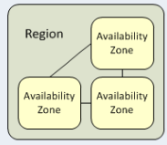
Cloud Terminology
Region : Regions are the physical locations where applications and data exist. Each region is a separate geographic area and are completely independent of each other.
Availability Zone : Each region has multiple, isolated locations known as Availability Zones. Each Availability Zone is isolated, but the Availability Zones in a region are connected through low-latency links.
Auto Scaling : Auto scaling is a cloud computing feature that allows users to automatically scale cloud services, like virtual machines (VM) and server capacities, up or down, depending on defined situations.
Elasticity : Elasticity is defined as "the degree to which a system is able to adapt to workload changes by provisioning and de-provisioning resources in an autonomic manner, such that at each point in time the available resources match the current demand as closely as possible".
Notes:
Region : In addition to choosing the cloud provider, most enterprise IT shops need to select the location where their cloud resources will reside. There are good reasons to understand the use of regions.
Each Amazon EC2 region is designed to be completely isolated from the other Amazon EC2 regions. This achieves the greatest possible fault tolerance and stability. First, administrators could run afoul of laws that don't allow data to leave the country or, in this case, the region. Second, there are performance considerations due to network latency around application configurations and requirements.
Availability Zones
When you launch an instance, you can select an Availability Zone or let us choose one for you. If you distribute your instances across multiple Availability Zones and one instance fails, you can design your application so that an instance in another Availability Zone can handle requests.
You can also use Elastic IP addresses to mask the failure of an instance in one Availability Zone by rapidly remapping the address to an instance in another Availability Zone. For more information, see Elastic IP Addresses.
An Availability Zone is represented by a region code followed by a letter identifier; for example, us-east-1a.
Autoscaling is the process of dynamically allocating the resources required by an application to match performance requirements and satisfy service-level agreements (SLAs), while minimizing runtime costs. As the volume of work grows, an application may require additional resources to enable it to perform its tasks in a timely manner. As demand slackens, resources can be de-allocated to minimize costs, while still maintaining adequate performance and meeting SLAs. Autoscaling takes advantage of the elasticity of cloud-hosted environments while easing management overhead. It does so by reducing the need for an operator to continually monitor the performance of a system and make decisions about adding or removing resources.
Elasticity :

Slide 16

The Simian Army
A set of tools (scheduled agents) that deliberately shuts down services, slows down performance, checks conformity, and tests the ability to survive them
Chaos Monkey – Shuts down instances randomly
Chaos Gorilla (AZ Failure)– Simulates outage of an entire availability zone
Chaos Kong: Region Failure
Latency Monkey (Artificial Delays)– Creates artificial delays in client-server communication
Conformity Monkey (Best Practices) – Shuts down instances which don’t comply to Best practices.
Security Monkey (Security Violations) – Finds security vulnerabilities such as improperly configured security groups
Doctor Monkey (Health Checks) – Performs health checks (such as CPU)
Janitor Monkey (Unused Instances) – Searches for unused resources and disposes of them
Howler Monkey : Monitors and reports AWS Limitations.
Source: http://www.ibm.com/developerworks/library/a-devops4/
Notes:
Chaos Kong: Netflix is now running in three different Amazon regions (Virginia, Oregon and Europe-West in Dublin), it has developed Chaos Kong, a tool that will simulate an outage effecting an entire Amazon region and then shift traffic to the remaining regions. Netflix uses Amazon’s Reserved Instances to ensure that it will have capacity available for a wholesale shift of traffic from one region to another.
AWS region failures are much rarer than single server failures; however, such failures do occur and Netflix (and other AWS users) need to be prepared for such occurrences. A recent AWS region failure left many major websites unavailable for 6-8 hours. However, because Netflix had already prepared for such failures with Chaos Kong, Netflix was minimally affected by the failure.

Slide 17
The Chaos Monkey
Chaos Monkey apply monitoring, diagnostics, randomization, and disruption to the infrastructure to ensure that engineers apply automation to limit the impact users experience when big problems do occur.
How
Service running on AWS and seeking out Auto Scaling groups and terminating instances per group.
Has a configurable schedule , running by default on non holiday weekdays between 9 am and 3 pm
Why
Prepare to fail to ensure you can tolerate instance failure
Learn from new unpredicted issues that may occur.
Check services automatic rebalance without user visual impact .
Source: http://www.slideshare.net/betclicTech/betclic-mini-trainingnetflixsimianarmy
Notes:
Netflix's Chaos Monkey is "a tool that randomly randomly terminates virtual machines Netflix operates in Amazon's Auto Scaling service. disables our production instances to make sure we can survive this common type of failure without any customer impact," Chaos Monkey In the year 2012, Netflix says its Chaos Monkey "has terminated over 65,000 instances running in our production and testing environments.
The Auto Scaling technology on Amazon's cloud should detect the termination of an instance and automatically configure a new, identical one to replace it. But the Chaos Monkey's random attacks can still suss out problems, like a patch gone wrong or a traffic load balancer that's failing to route requests around offline instances.

Slide 18
The Chaos Gorilla
Chaos Gorilla
Simulate an Availability Zone becoming unavailable
Validate multi Availability Zone Redundancy
Deploy to multiple AZs by default
Source: http://www.slideshare.net/betclicTech/betclic-mini-trainingnetflixsimianarmy
Notes:
Chaos Gorilla takes out an entire Availability Zone.
AWS has multiple regions in different parts of the world, such Eastern USA, Western USA, Asia Pacific and Western Europe.
Each region has multiple Availability Zones. These are equivalent to physical data centers in different geographic locations - for example, the US East region is located in Virginia but has 3 separate Availability Zones.
Running Chaos Gorilla ensures that our services is running correctly in multiple Availability Zones, and that we have sufficient capacity in each zone to handle our traffic load.
Runs of Chaos Gorilla are announced ahead of time, and our Reliability Engineering team sets up an incident room where engineers from each service team can watch progress.

Slide 19
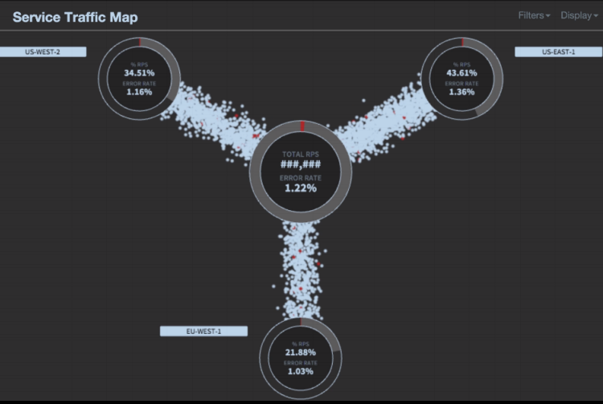
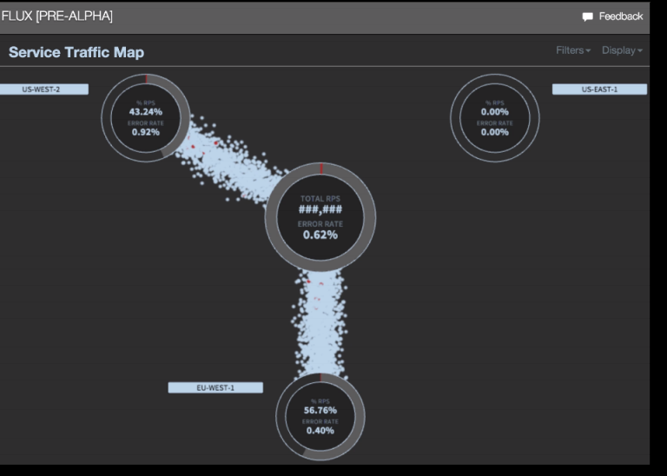
The Chaos Kong
Chaos Kong
Kill entire region and shift traffic globally
Used to validate our active - active region strategy
Traffic has to be switched to a new region
Run once every few months.
US WEST -2
US EAST -1
US WEST -2
US EAST -1
Source: http://www.slideshare.net/betclicTech/betclic-mini-trainingnetflixsimianarmy
US WEST -1
US WEST -1
Notes:
Netflix operates in three regions : US – west 2 , US – East 1 and EU – west 1

Slide 20
The Latency Monkey
How
Service running on AWS and inducing artificial delay on the Restful communication and measuring upstream services response.
With Large delays, a node or an entire service downtime can be simulated without physically bringing the instances down.
Why
Simulate services degradation
Test that services respond appropriately to degradation .
Test the ability to survive an entire service downtime.
Test the fault tolerance of a new service by simulating the failure of its dependencies without affecting the rest of the system.
Source: http://www.slideshare.net/betclicTech/betclic-mini-trainingnetflixsimianarmy
Notes:
So we can deal with instances disappearing individually, or in large numbers. But what if instances are still there, but running in a degraded state ? Because our architecture involves so many interdependent services, we have to be careful that problems with one service don’t cascade to other services.
This is where Latency Monkey comes in. It can simulate multiple types of degradation: network connections maxing out, high CPU loads, high disk I/O and running out of memory.
Degradation in a service oriented architecture is extremely hard to test exhaustively. With Latency Monkey we can introduce degradation in a controlled way (like the recommendations example I mentioned earlier), find any problems in dependent services and fix them, then verify those fixes.
Some service teams even discovered dependencies they didn’t know they had by running Latency Monkey and finding unexpected degradation in the dependent services.

Slide 21
The Conformity Monkey
How
Service running on AWS and finding instances that don’t comply to predefined best practices. ( for ex : all instances should have same system configuration , same version and configuration of service )
Marks non compliant instances , shuts them down and notifies corresponding owners .
Check is performed every hour by default.
Notification is sent only once per day at noon time
Why
Non compliant instances , like not belonging to and Auto scaling group are trouble waiting to happen .
Anticipate and give the owners a chance to relaunch them properly.
Source: http://www.slideshare.net/betclicTech/betclic-mini-trainingnetflixsimianarmy
Notes:
One other key aspect of running so many services, all with dozens or hundreds of instances, is that it’s very important to keep all of the instances consistent. They should all have the same system configuration and the same version and configuration of the service, for example. This decreases the complexity / surface area of the testing
We use Conformity Monkey to automate these checks.
It runs over all services at a fixed interval, and notifies service owners when any of the conditions are not met. An email is sent containing a list of rule violations, each with a list of non-conforming instances.
Here are a few examples of the things we check:
Instances should be in the correct security groups so that they are reachable by other services and our monitoring and deployment tools.
Instances shouldn’t have been running for more than a given time, which depends on how often the service is deployed. Older instances could be running an out of date version of the service.
Instances should all have a valid health check URL so that our monitoring tools can know whether they are running properly.

Slide 22
The Security Monkey
How
Service running on AWS and extension of conformity monkey.
Finds security violations and vulnerabilities
Why
Track improperly configured security groups to terminate offending instances .
Ensure that all their SSL and DRM certificates are valid and are not coming up for renewal.
Source: http://www.slideshare.net/betclicTech/betclic-mini-trainingnetflixsimianarmy
Notes:
DRM- Digital Rights management. DRM technologies try to control the use, modification, and distribution of copyrighted works (such as software and multimedia content)
Security Monkey is similar to Conformity Monkey, but specializes in tracking and evaluating security changes.

Slide 23
The Doctor Monkey
How
Service running on AWS and tapping into health checks running on each instance.
Monitors other external health signs like cpu load or memory usage
Remove unhealthy detected instances from service .
Why
Give time to service owners to root cause the problem.
Eventually terminate the deleted instances.

Slide 24
The Janitor Monkey
How
Service running on AWS and searching for unused resources
Mark resources as clean-up candidates
Schedule resources disposal time
Clean-up deadline is defined in the rule that allows to mark the resource
Notify the owners of marked resources
Notification time is 2 business days before the clean-up deadline by default
During the period the owner can decide to clean-up or retain the resource
Dispose resources once deadline is met
Why
Ensure that the cloud environment is running free of clutter and waste
Save costs on operation
Free up engineering time, no need to manage unused resources
Source: http://www.slideshare.net/betclicTech/betclic-mini-trainingnetflixsimianarmy
Notes:
Janitor Monkey looks for unused resources and deletes them. Examples are machine images or launch configurations that are no longer in use by any running instances.

Slide 25
The Howler Monkey
How
Service running on AWS and monitoring whether a workload meets AWS possible limitations and reports it.
Why
Maintain healthy operations by ensuring that AWS limitations are respected.
Save costs on operations.
Source: http://www.slideshare.net/betclicTech/betclic-mini-trainingnetflixsimianarmy
Notes:
Howler Monkey warns us if we’re running out of AWS resources - for example, if we have nearly maxed out on the number of instances of a given type that are available in a particular region.
It also looks for SSL certificates that are about to expire.
https://docs.google.com/presentation/d/115e6_eEvSxM43Mz4zKLl8gfQxASjhrbka6D2jJ7baSo/edit#slide=id.g3f5c82004_111_339

Slide 26
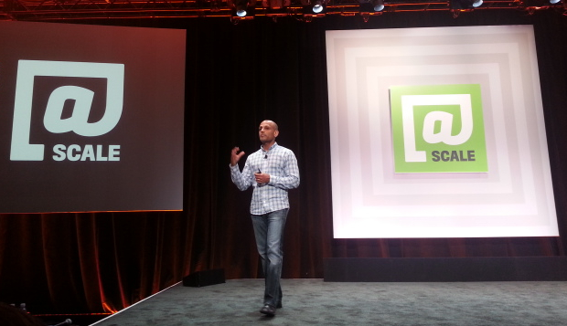
Facebook Turned Off Entire Data Center to Test Resiliency
“Project Storm"
One of the biggest things FB learned was that traffic management and load balancing were “really, really hard” during an outage
Another big lesson was that it takes a long time to bring a data center back up after an outage. “When we take a data center or a region down, that actually happens much faster,” Parikh said
Facebook has developed an automated runbook that includes every step for turning a data center off or for turning it back on. The runbook includes both automated and manual tasks.
During each drill, the team times itself on every individual task to continue looking for improvement opportunities. “You really want to time this kind of like a pit stop at a race,” he said.
ON July, 2014
Source: http://www.datacenterknowledge.com/archives/2014/09/15/facebook-turned-off-entire-data-center-to-test-resiliency/
Notes:
It’s a similar lesson to the one you learn as a child, when you realize a toy is much easier to take apart than to put back together, he said. Only this is less like putting together a toy and more like putting together an aircraft carrier.

Slide 27
Q&A

Slide 28

THANK YOU!
Email: solutions@valuemomentum.com
ASIA PACIFIC
ValueMomentum Towers Plot No 36 & 37, Gachibowli, Financial District, Nanakramguda, Hyderabad – 500032, India
US HEADQUARTERS
220 Old New Brunswick Road; Suit 100
NJ 08854
Tel: (908) 755 0048

Slide 29
What is Cloud
Cloud Computing is “On demand computing resources , delivered to you over the internet “
A computing service you traditionally did local (On-premises ) , now performed remotely , across the Internet (off – premises) .
Cloud computing is an approach to computing that leverages the efficient pooling of an On-demand , self-managed , virtual infrastructure (According to VMware..)
Traits of Cloud
Elastic Scales up and down quickly
Metered Pay only for what you use
Self-Service No( or reduced ) need for IT Experts
Source: https://msdn.microsoft.com/en-us/library/dn600215.aspx

Slide 30
Benefits & Risks of Cloud
Benefits
Fast access to resources or applications you or your company needs
Only Pay for what you use
No capital expenditure to get started
Potential to eliminate the need for local IT staff to maintain Infrastructure
Potential to lower costs
Deploy what you need , yourself , with Self service
Allow IT staff to focus on business outcome
Risks
Placing your Trust in the cloud provider
Potential for data loss
Potential for slow access to your data
Potential questions related to legal / regulatory
Potential for loss of customization
Potential for unknown costs.
Source: https://msdn.microsoft.com/en-us/library/dn600215.aspx

Slide 31
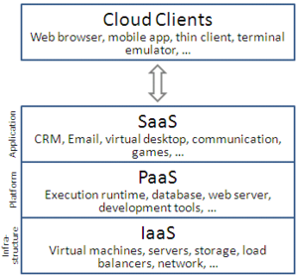
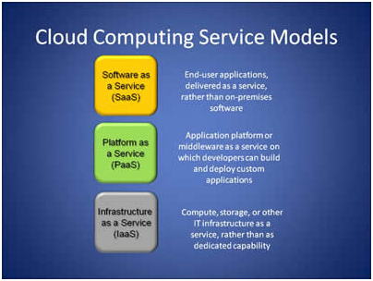
Forms of Cloud

Slide 32
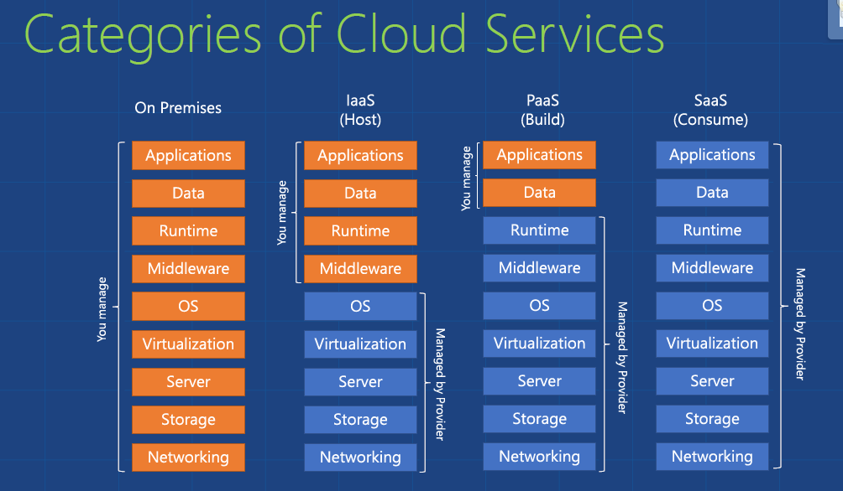
Forms of Cloud

